Slide 1
Discussion 12: Graphs
Christine Zhou

Slide 2
Agenda
Announcements
Let’s try to get through all the worksheet!

Slide 3
Announcements
Congratulations on finishing the project and getting through these past few weeks!
Stay strong, keep pushing through :)
HW 7 has been released
Threads for each section on Piazza
Want to chat? Email me!

Slide 4
Graphs
Can represent relationships!
Family trees, cities and roads, etc.
Lots of terminology:
Vertices/nodes: graphs are made up of a set of these
Edges: connect two vertices together (can be (un)directed)
Adjacent: vertices with an edge between them
Labels/Weights: the value of a vertex or edge
Path: vertices connected by edges
Cycle: path whose first and last vertices are the same
Connectivity: vertices are connected if there is a path in between them; graphs are connected if all vertices are connected

Slide 5
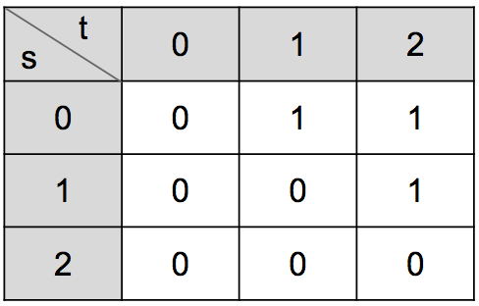
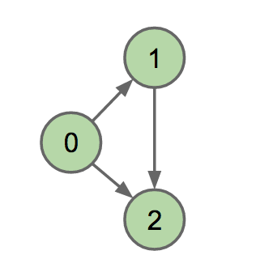

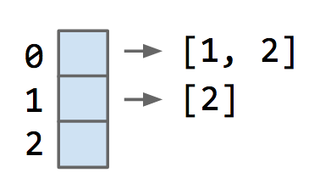
How do we represent a graph?
Adjacency matrix
Edge set
Adjacency list

Slide 6
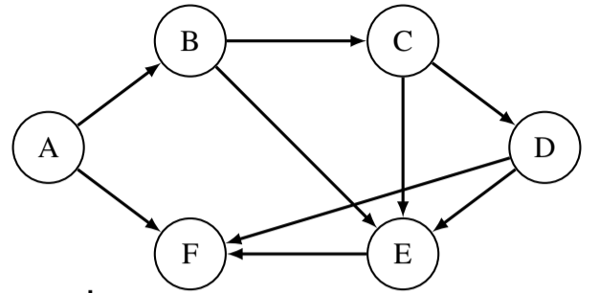
1 Graph Representation
Represent the graph above with an adjacency list and an adjacency matrix representation.

Slide 7
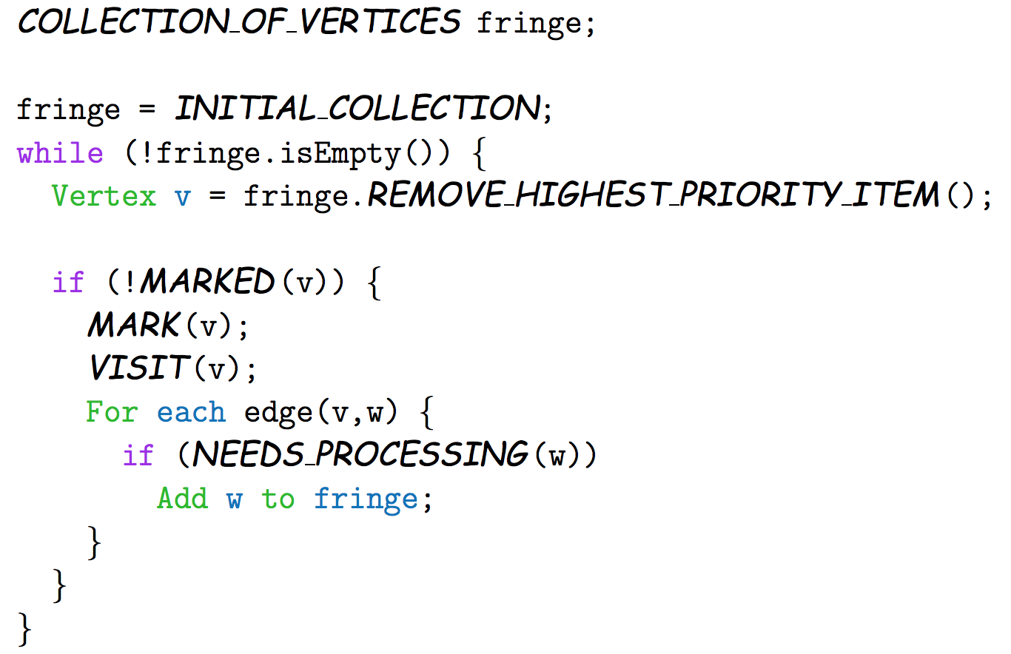
General Graph Traversal Algorithm
Stack fringe = new Stack(); Set visited = new Set(); fringe.push (startVertex); while (!fringe.isEmpty()) { Vertex v = fringe.pop(); if (!visited.contains(v)) { process(v); //do something with v for (Vertex neighbor: v.neighbors) { fringe.push(neighbor); } visited.add(v); } }

Slide 8
Depth First Search (DFS)
Explore as far as possible before going back
Search down entire subgraph of a child before moving onto the next child
If there are multiple children that you could explore, break ties alphabetically
Preorder: mark the current vertex, then visit the children
Postorder: visit the children, then mark the current vertex
Fringe is a stack
Runtime: O(V + E)
Visualization: here
RECURSIVE IMPLEMENTATION OF DFS
private void dfs(Graph G, int v) {
marked[v] = true;
for (int w : G.adj(v)) { if (!marked[w]) {
edgeTo[w] = v;
dfs(G, w);
}
}
}

Slide 9
Breadth First Search (BFS)
Search graph equidistantly from the source
Start at the root, search all the children, then do the same with all the other children
Fringe is a queue
Runtime: O(V + E)
Can be helpful in finding shortest paths on unweighted graphs
ITERATIVE IMPLEMENTATION OF BFS
private void bfs(Graph G, int s) {
Queue<Integer> fringe = new Queue<>();
fringe.enqueue(s);
marked[s] = true;
while (!fringe.isEmpty()) { int v = fringe.dequeue();
for (int w : G.adj(v)) { if (!marked[w]) {
fringe.enqueue(w);
marked[w] = true;
edgeTo[w] = v;
}
}
}
}

Slide 10

2 Searches and Traversals
Run depth first search (DFS) and breadth first search (BFS) on the graph starting from node A. List the order in which each node is first visited. Whenever there is a choice of which node to visit next, visit nodes in alphabetical order.

Slide 11
Topological Sorting
Do not explore a node unless it is a source node or all incoming nodes have been explored
If we have a graph of classes and prerequisites, a topological sort will give us an ordering to take the classes
Can run DFS postorder and reverse the ordering to get a valid topological sort
Can only work on DAG (directed acyclic graphs)
Think about the prerequisites. Does it make sense to have cycles in a graph of prerequisites?

Slide 12
3 Topological Sorting
Give a valid topological ordering of the graph. Is it unique?

Slide 13
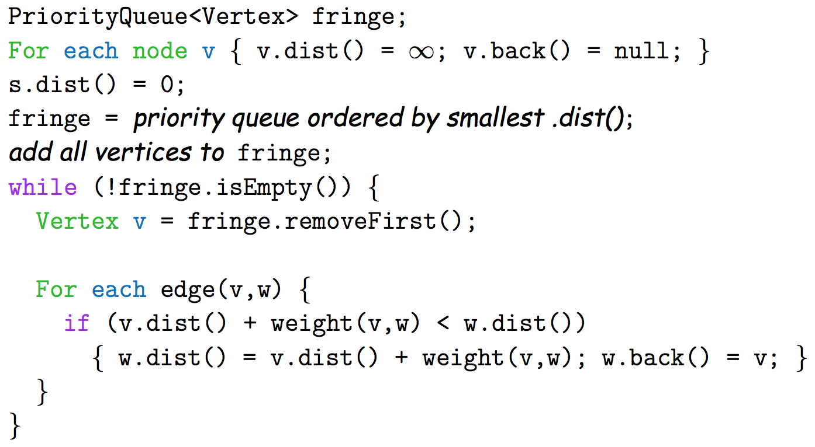
Dijkstra’s Algorithm
Find shortest paths to all the vertices with edge weights != 1
Fringe is a priority queue
Runtime: O((V+E) log V)
Idea: when you pop an element off fringe, it will be the shortest path!

Slide 14
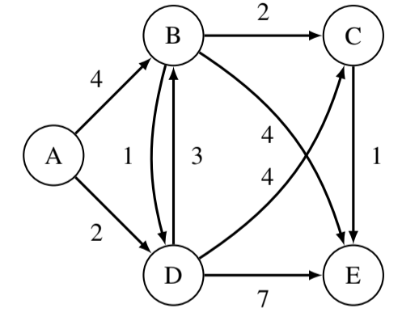
4 Dijkstra’s Algorithm
Given the following graph, run Dijkstra’s algorithm starting at node A. At each step, write down the entire state of the algorithm. This includes the value dist(v) for all vertices v for that iteration as well as what node was popped off of the fringe for that iteration.

Slide 15
5 Dijkstra’s Correctness
What must be true about our graph in order to guarantee Dijkstra’s will return the shortest paths tree to every vertex? Draw an example of a graph that demonstrates why Dijkstra’s might fail if we do not satisfy this condition.
Note: Is this true in all cases? Can you think of an exception to this general rule?

